Slide 1

Digital Portfolio
STUDENT NAME: GOWRI SATHANA R
REGISTER NO AND NMID: 2422j0269/asbru202422j0269
DEPARTMENT: BACHELOR OF COMPUTER APPLICATION
COLLEGE: THAVATHIRU SANTHALINGA ADIGALAR ARTS
SCIENCE &TAMIL COLLEGE
1
Notes:
1

Slide 2


PROJECT TITLE
2

Slide 3



AGENDA
Problem Statement
Project Overview
End Users
Tools and Technologies
Portfolio design and Layout
Features and Functionality
Results and Screenshots
Conclusion
Github Link
3/21/2024 Annual Review
3

Slide 4
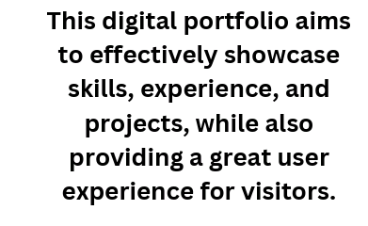

PROBLEM STATEMENT
4

Slide 5
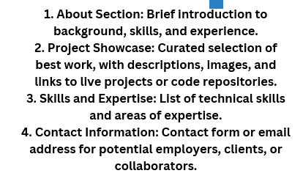

PROJECT OVERVIEW
5

Slide 6
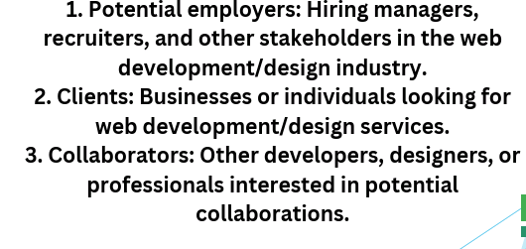

WHO ARE THE END USERS?
6

Slide 7

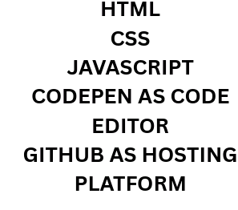
TOOLS AND TECHNIQUES
7

Slide 8
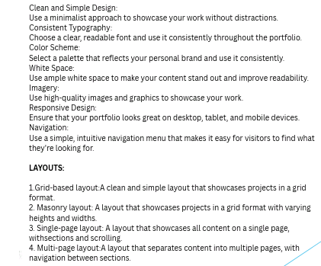
POTFOLIO DESIGN AND LAYOUT
8

Slide 9
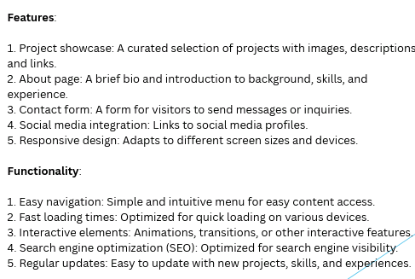
FEATURES AND FUNCTIONALITY

Slide 10
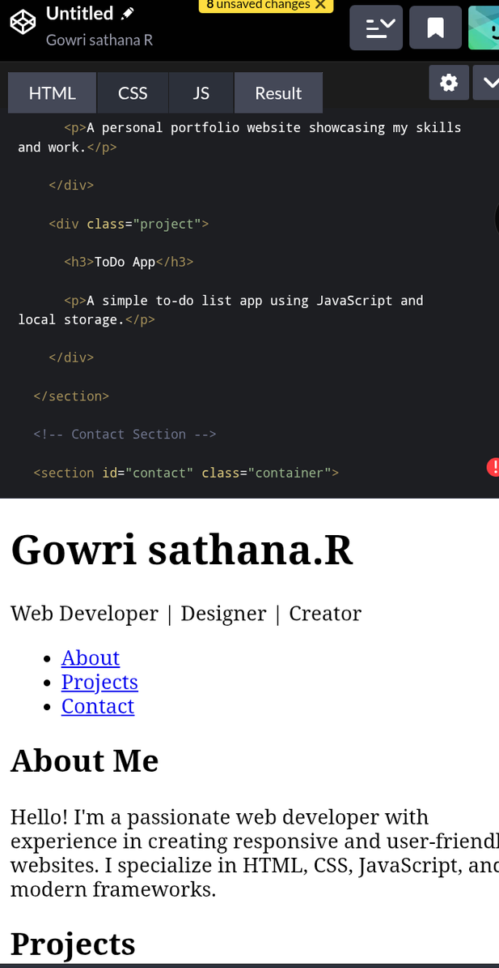
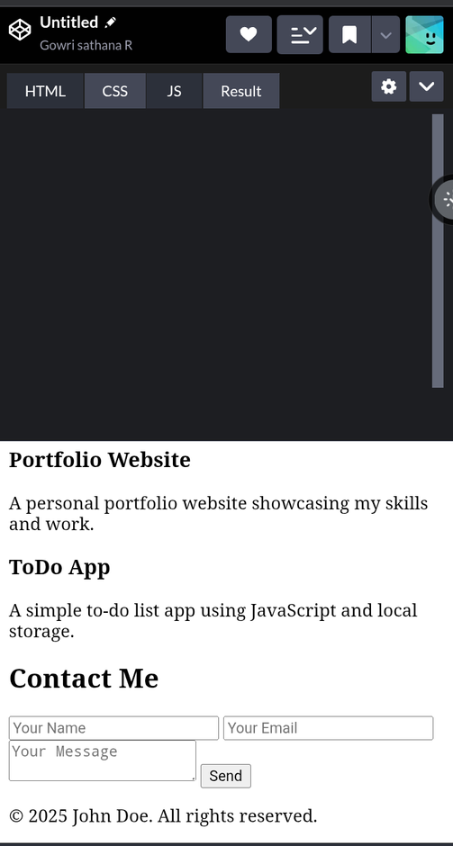

RESULTS AND SCREENSHOTS
3/21/2024 Annual Review
10

Slide 11

CONCLUSION
11

